Slide 1

PRESENTED BY : Kotha Nithya (17UK1A0544) Poshala Amulya (17UK1A0502) Sharath Kumar Gongalla (17UK1A0557) Podila Madhu (17UK1A0542)
VAAGDEVI ENGINEERING COLLEGE
MINI PROJECT PRESENTATION
TEAM-A_1
PROJECT NAME:- VISA APPROVAL PREDICTION
PROJECT GUIDE:
Dr . Rakesh Nayak
professor

Slide 2
TABLE OF CONTENTS:
Abstract
Existing problem
Proposed solution
Requirements
Design
Result analysis
Output screens
Conclusion
Future enhancement

Slide 3
ABSTRACT
Our work focuses on the data science challenge problem of predicting the decision for past immigration visa applications using supervised machine learning for classification.
We describe an end-to-end approach that first prepares historical data for supervised inductive learning, trains various discriminative models, and evaluates these models using simple statistical validation methods.
The H-1B visa in United States allows employers to employ foreign workers in speciality occupations.
The report addresses the approach to predict the case status of the filed H-1B Visa petitions using various data.
As the H-1B visa category is one of the highly coveted ones, this approach can be used by both the individual and the employer in between applying for the visa and getting the final decision.
We believe that this project could be a useful resource both for the future H-1B visa applicants and the employers who are considering to sponsor them.

Slide 4
EXISTING PROBLEM
The previous models have high time complexity and space complexity.
Previous model has used prediction algorithm based on K-means clustering, it provided prediction accuracies for only a small subset of job types instead of an average one.

Slide 5
PROPOSED SOLUTION:
DECISION TREE:
Decisions trees are the most powerful algorithms that falls under the category of supervised algorithms.
Decision Tree can be used for both classification and Regression problems, but mostly it is preferred for solving Classification problems.
Decision trees can be constructed by an algorithmic approach that can split the dataset in different ways based on different conditions.
The two main entities of a tree are decision nodes, where the data is split and leaves, where we got outcome. A major goal of the analysis is to determine the best decisions.
In a decision tree, for predicting the class of the given dataset, the algorithm starts from the root node of the tree. This algorithm compares the values of root attribute with the record (real dataset) attribute and, based on the comparison, follows the branch and jumps to the next node.
For the next node, the algorithm again compares the attribute value with the other sub-nodes and move further. It continues the process until it reaches the leaf node of the tree.

Slide 6
SOFTWARE REQUIREMENTS :
Jupyter Notebook Environment
Spyder Ide
Python(pandas , numpy , matplotlib , seaborn , sci-kit)
HTML
Flask

Slide 7
HARDWARE REQUIREMENTS:
Windows 7,8 or 10(32 or 64 bit)
RAM-4GB
Processor:1.5Hz or above
HDD:100GB or above

Slide 8
DESIGN BLOCK DIAGRAM
Dataset collection
Data
pre-processing
Checking null values
Data Visualization
Testing model
Train and Test split data
Splitting data
Label encoding & feature creation
Incorporate with HTML & Flask
Deployment

Slide 9
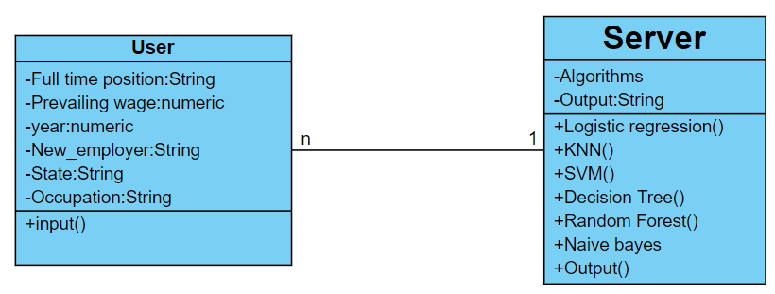
UML DIAGRAMS:
CLASS DIAGRAM

Slide 10
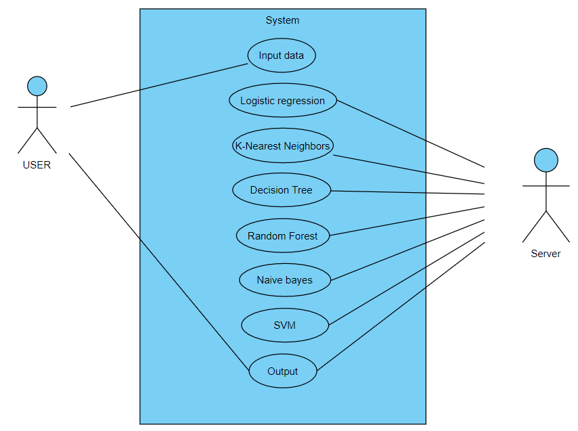
USECASE DIAGRAM:

Slide 11
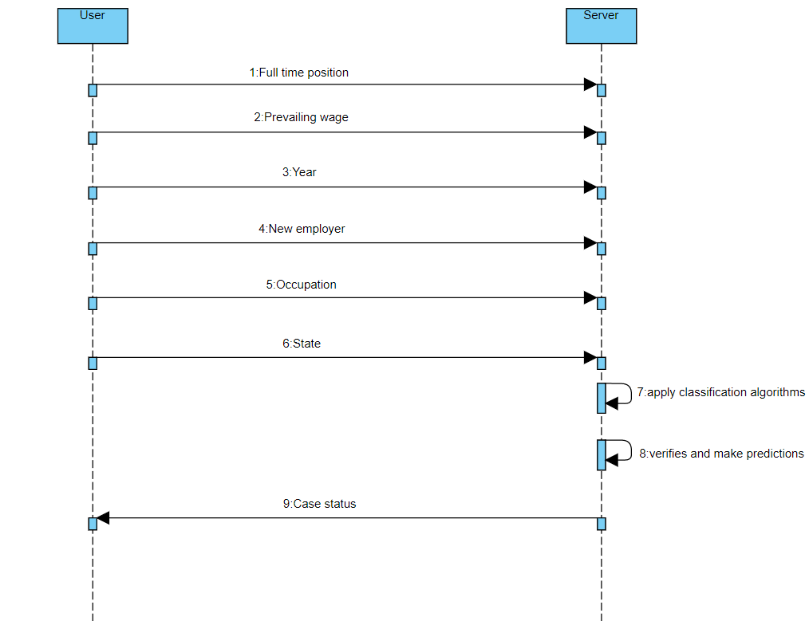
SEQUENCE DIAGRAM:

Slide 12
RESULT ANALYSIS
CLASSIFIERS | ACCURACY | AUC_ROC
Logistic Regression | 60% | 0.52
K-Nearest Neighbors | 63% | 0.59
Decision Tree | 74% | 0.71
Naïve Bayes | 62% | 0.57
Random Forest | 74% | 0.70
Support Vector Machine | 62% | 0.55
Among all the classifiers that were implemented, it was observed that Decision Tree out-performed four algorithms by a substantial margin and Random Forest by an extremely small amount.
The high prediction accuracy of 74% and AUC value of 0.71 combined with the scalability nature of Decision Tree make them a good classification learning algorithm for medium to large data sets such as this test bed.

Slide 13
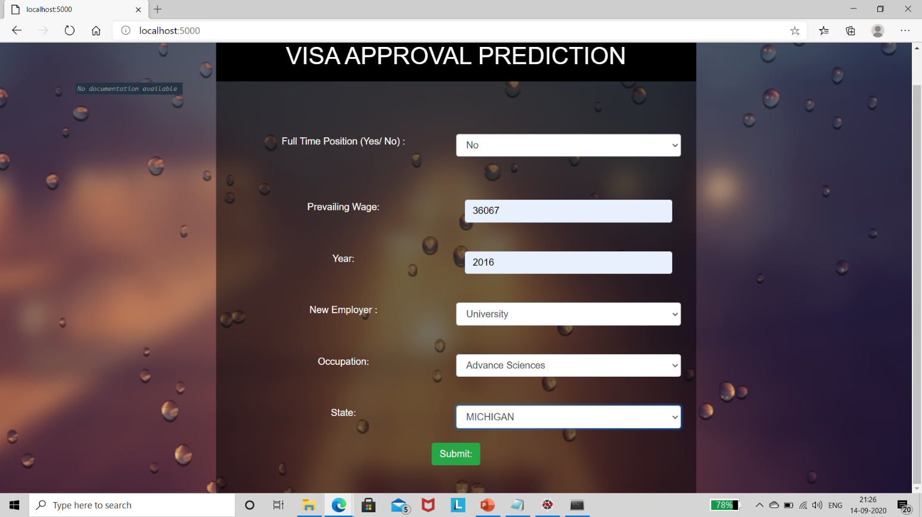
OUTPUT SCREENS
INPUT

Slide 14
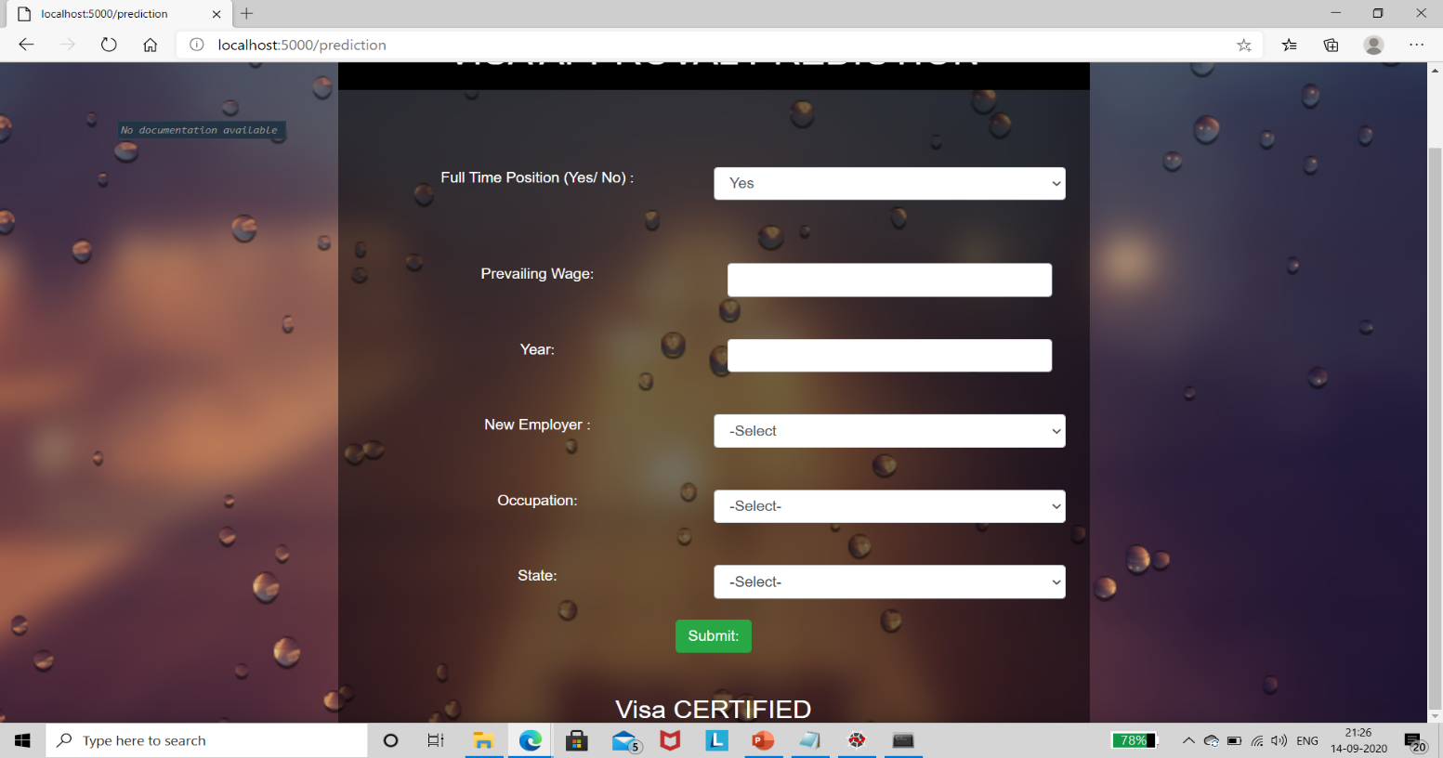
OUTPUT

Slide 15
CONCLUSION
The utilization of machine learning related algorithm enables us to analyze the data based on training and learning steps.
Therefore, it will help us to predict the approval and deny rate of H-1B visa of the testing year by Decision Tree algorithm.
Decision Tree Classifier performed the best in terms of accuracy and prediction . In the end, it is indeed possible to predict the outcome of H-1B visa applications based on the attributes of the applicant using machine learning.
The analysis of H-1B visa application might help to guard students, individuals to accomplish their American Dreams.

Slide 16
FUTURE SCOPE
This dataset presented interesting challenges for dealing with complex dataset. The data still needed to cleaned, and more Machine Learning algorithm , could exploited and implemented.
Supplemental data concerning the Standard Occupational Classification (SOC) can be gathered and used in coordination with this data set .
By using the wage evaluations and ranges under SOC, the wage attribute in this data set can be correctly put in to a range of salaries which can then be used to classify the visa petitions based on occupation roles rather than location wise.
A rigorous analysis of other machine learning algorithms other than the classification algorithms can also be done in future to investigate the power of machine learning algorithms for visa approval prediction.

Slide 17
Any Queries?

Slide 18
THANK YOU

